Slide 1
Python (day 3)
Nick Anderson

Slide 2
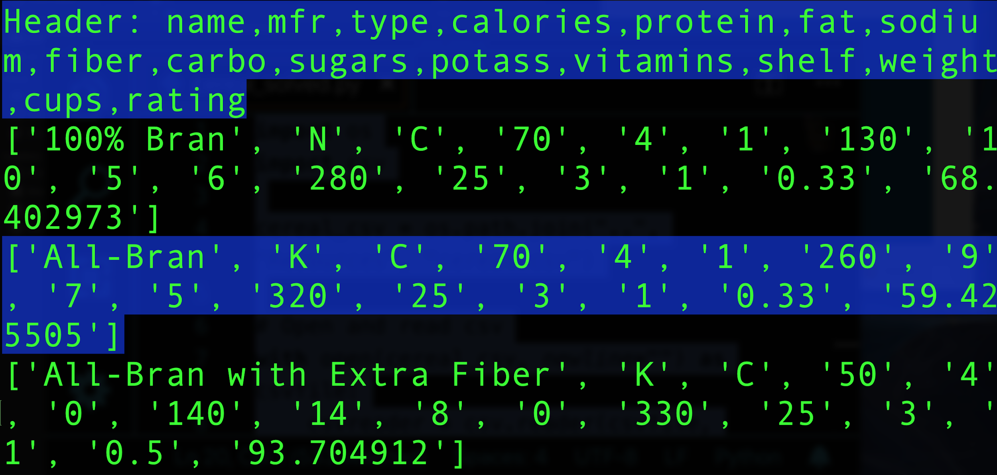
Serial Cleaner (your turn, 20 min.)

Slide 3
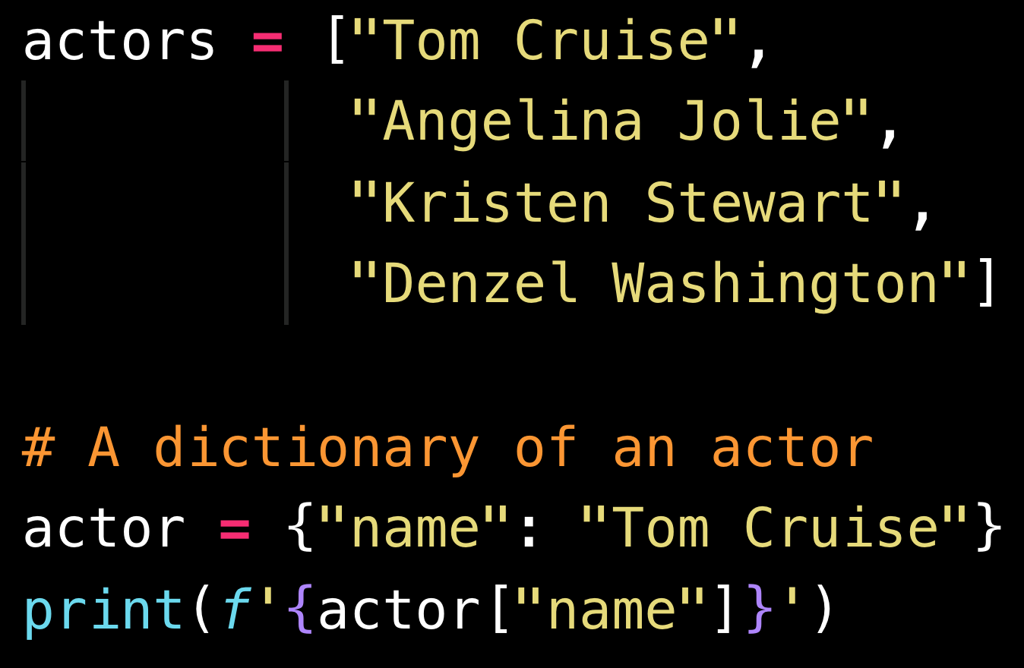
Lists compared to Dictionaries

Slide 4
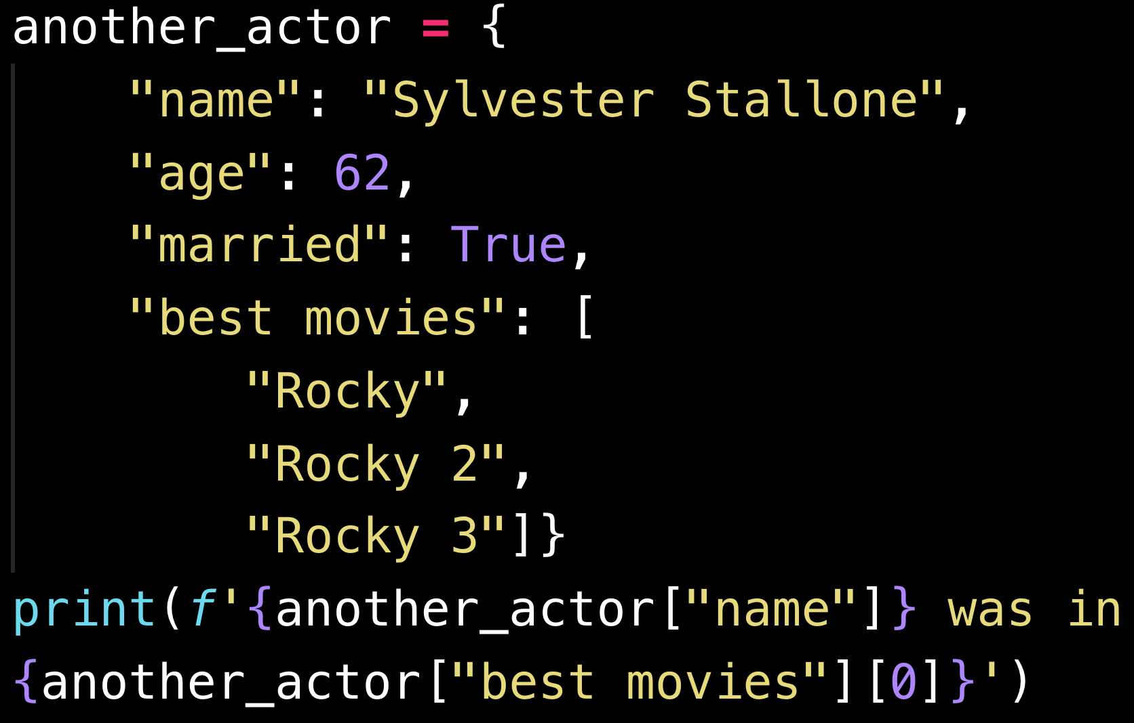
Another Dictionary Example

Slide 5
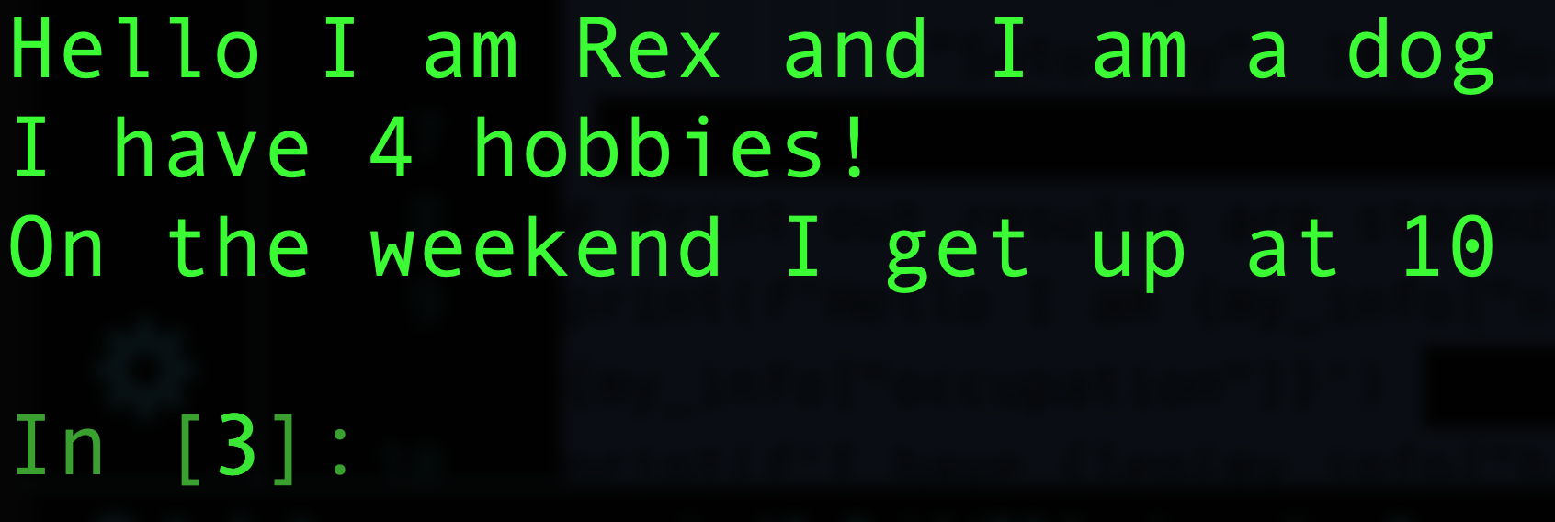
Hobby-Book (your turn, 15 min.)

Slide 6
List Comprehensions (all together!)

Slide 7
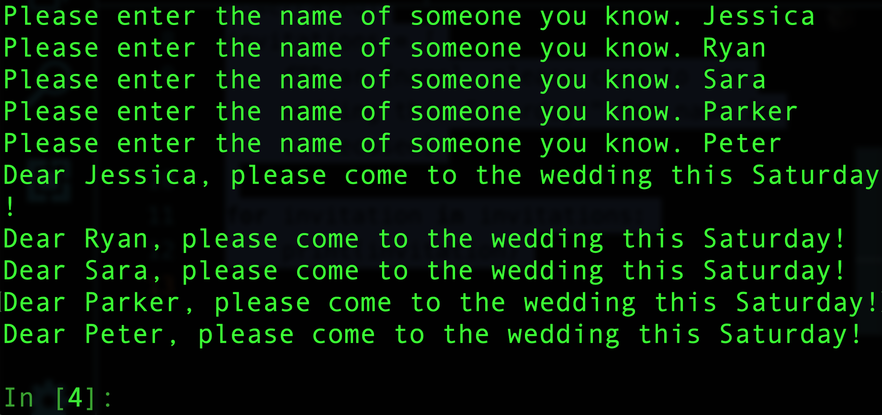
HINT: use .lower() and .title()
List Comprehensions (your turn, 10 min.)

Slide 8
Functions (all together!)

Slide 9
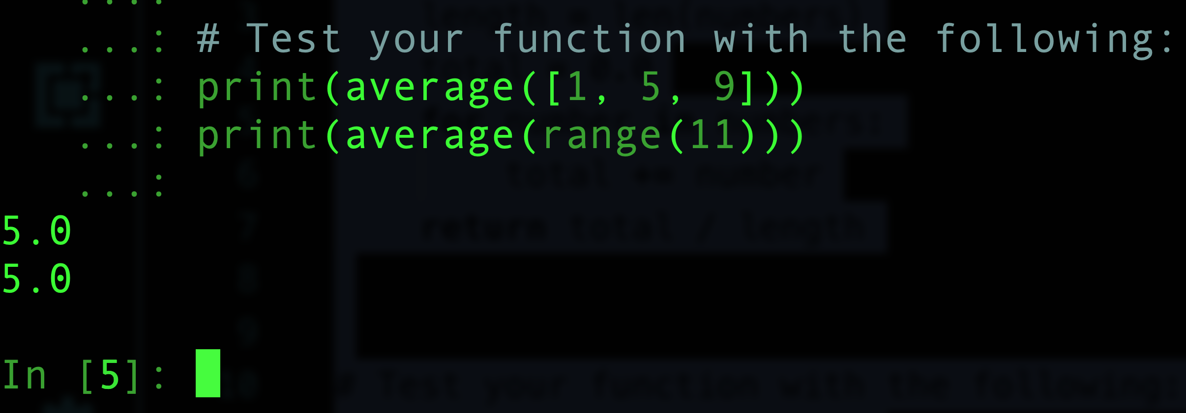
Functions (your turn, 10 min.)

Slide 10
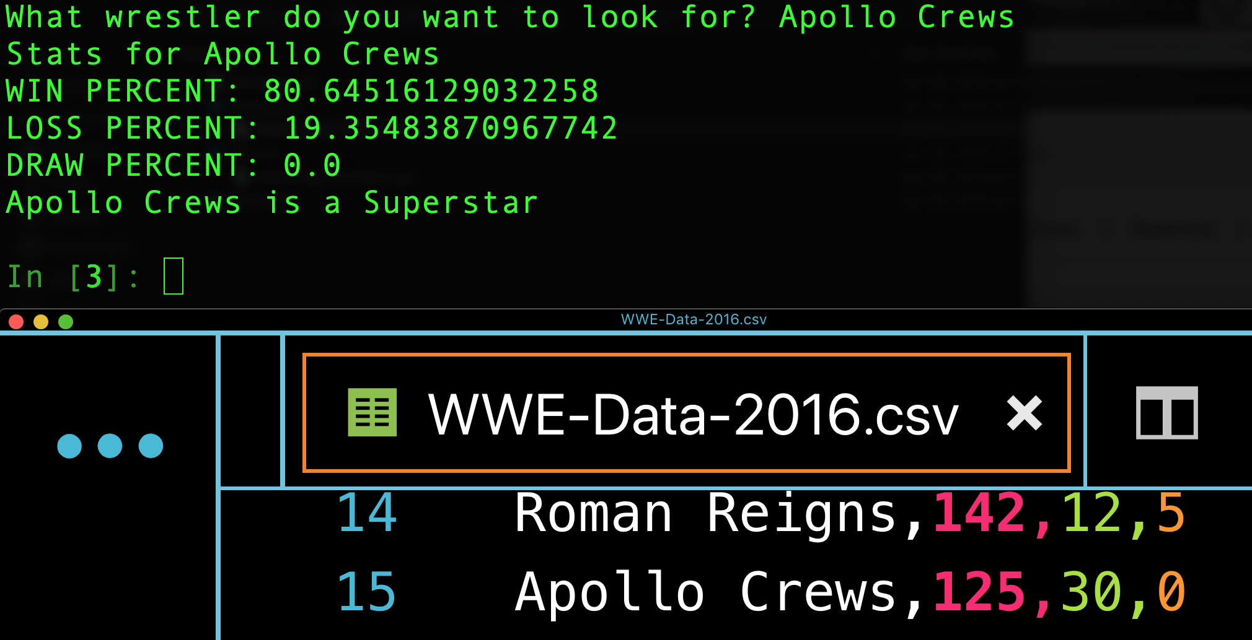
Wrestling With Functions (partners, 15 min.)

Slide 11
Break (15 min.)

Slide 12
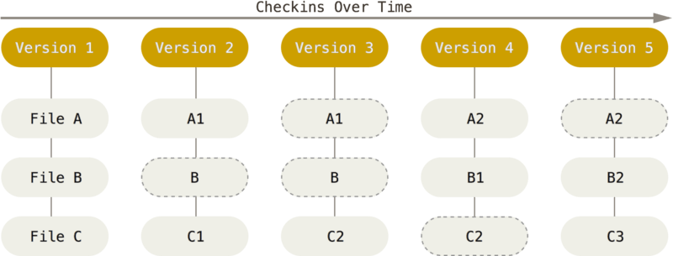
Git Overview

Slide 13
Introduction to Git (part 1)
Step 1: Open terminal (or git-bash for Windows users) and navigate to the home folder using “cd ~”.
Step 2: Type in “git clone <repository link>” in the terminal to clone the repo to the current directory.

Slide 14
Introduction to Git (part 2)
Step 3: Type “git status”, this displays the status of files in the folder.
Step 4: type “git add .”, this adds all the files into a staging area
Step 5: type “git status” again, to verify files were added.

Slide 15
Introduction to Git (part 3)
Step 6: Type “git commit -m <add commit message here>” in order to commit all the files to your repo and adds a message.
Step 7: Type “git push origin master” in order to pushes the changes up to GitHub.
Navigate to the repo on Github.com to see that the changes have been pushed up.
Finally navigate to the repo on Github.com to see that the changes have been pushed up.

Slide 16
Questions?
Please review!!!
See our video guide (Slacked out)
for topics we covered this week.

